Slide 1

Beginner’s Guide to R
## Chelsea Faber, PhD -----------------------
# Biostatistics Hands-On Workshop
# May 3, 2024

Slide 2



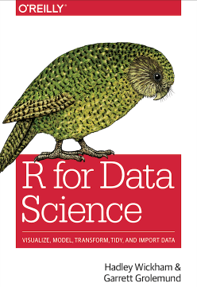
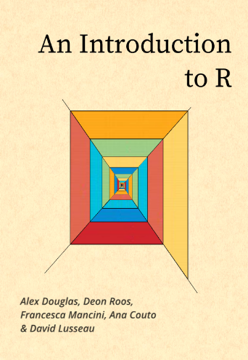
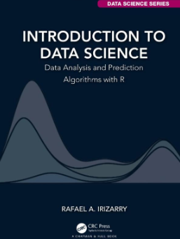
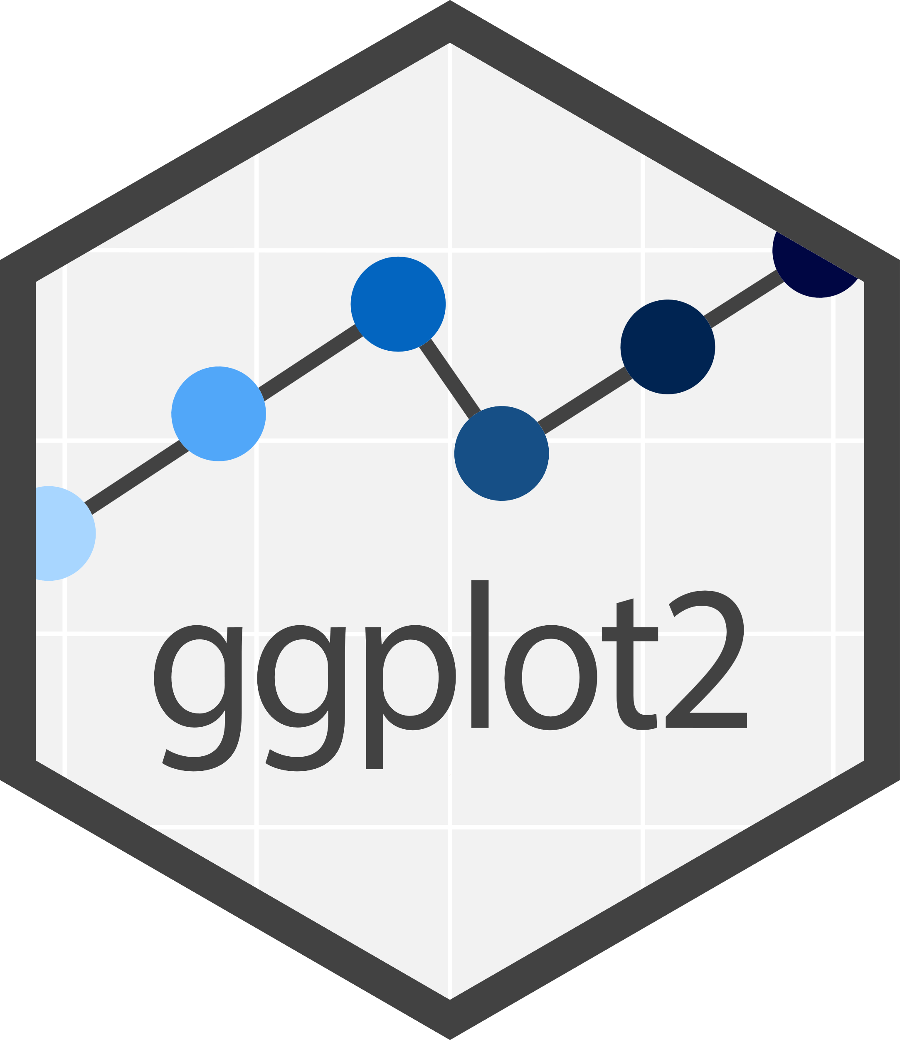





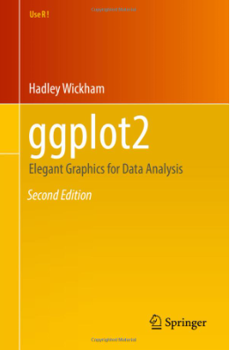
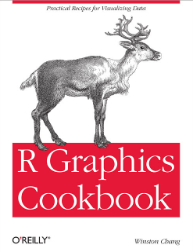
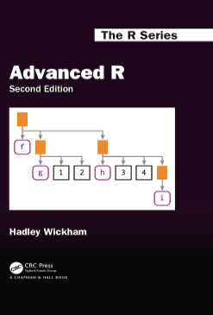
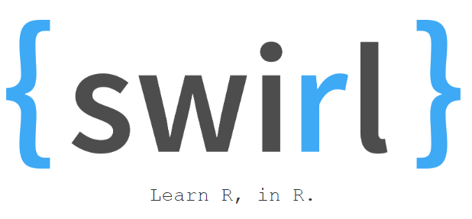
Resources
# Online Learning # Communities
# Cheatsheets
# Free e-books

Slide 3
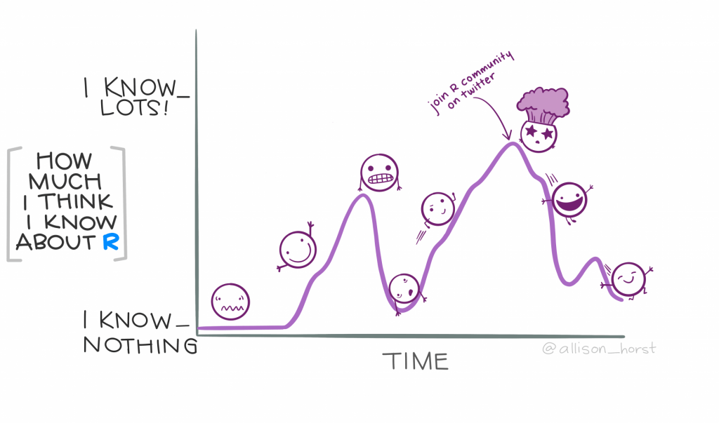
# What is R?
R is a programming language: a set of rules and conventions that allow humans to translate our ideas into instructions computers can understand
Using R for data analysis requires us to learn its vocabulary and grammar, like any other language.

Slide 4
# Why R?
Free!
Open source
Intuitive user-interface (R Studio)
Available for Windows, Mac, and Linux
Very popular and well-supported
Beginner friendly
Extensive packages and functions
Facilitates efficient and reproducible data analyses

Slide 5

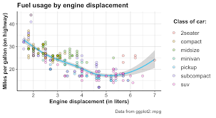





How can R improve my data analysis workflow?
Reproducibility
Checkout
Version 3
Integration with version-control
software
Version 2
File
Version 1
Version database
Speed and automation
Scalability

Slide 6


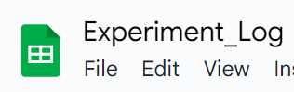
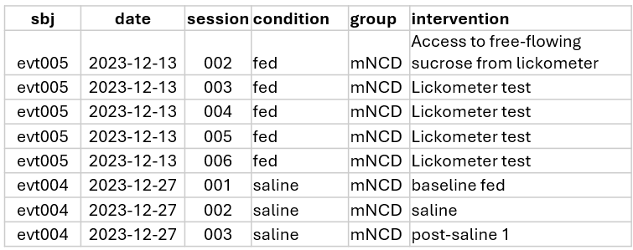

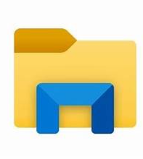
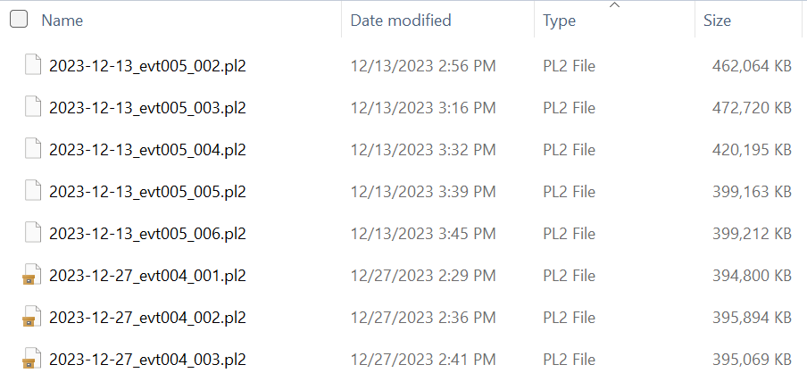

A quick note on data standards for automation
Tidy data
Consistent file names
Centralized data
Each variable in its own column.
Experiment_Log.gsheet
Log
Data
Each observation in its own row.
Exp1
Data >
Analysis
Each value in its own cell.
Exp2
Analysis
Wickham, J Stat Software 2014

Slide 7
# Getting started

Slide 8
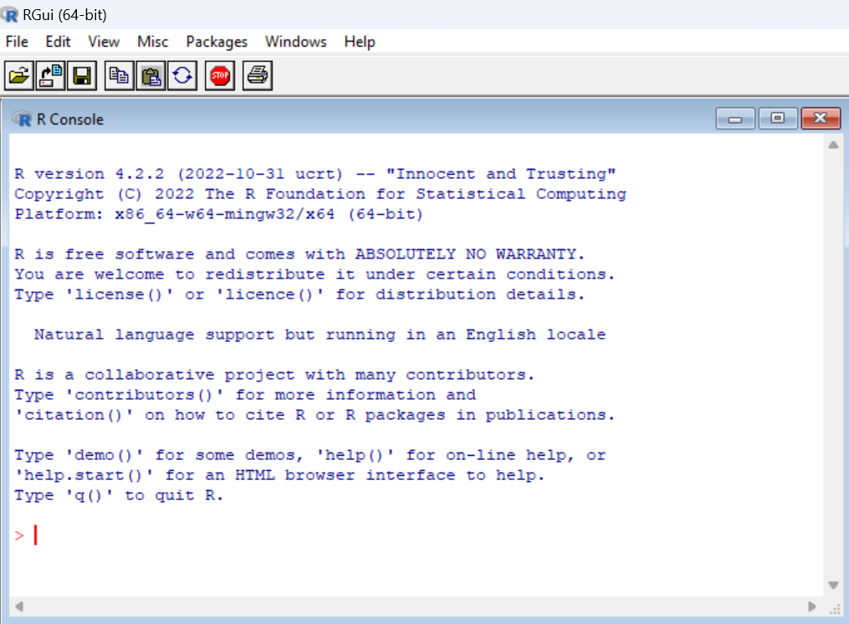
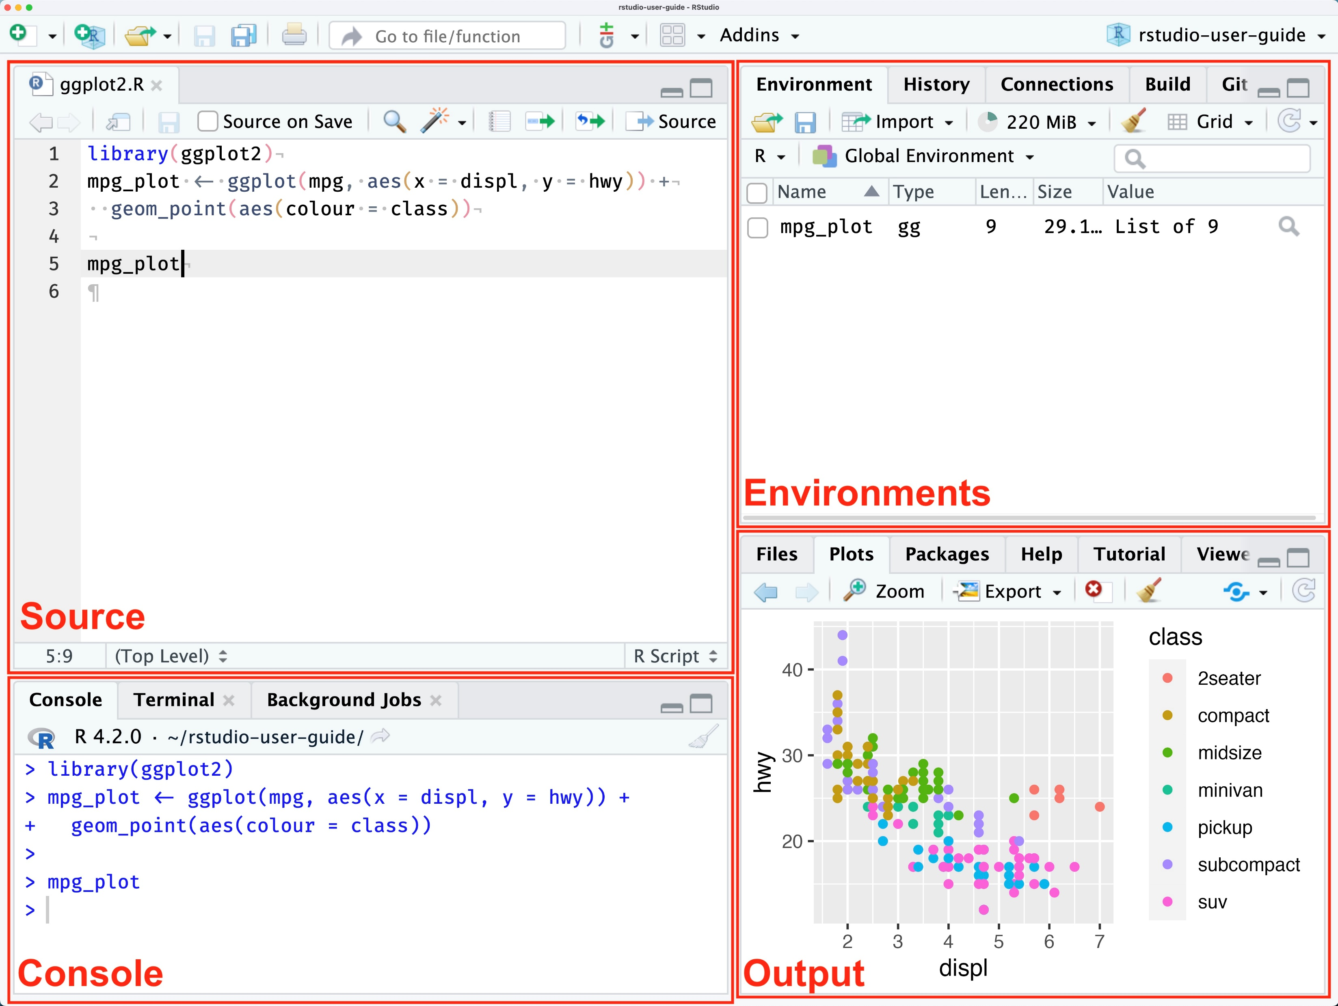

R vs. R Studio IDE
R is a programming language
R Studio is an integrated development environment (IDE) software that optimized for working with R language.

Slide 9
Relationship b/t R and R Studio
R as a programming language
IDE
Where to download updates

Slide 10
# Code demo

